Slide 1


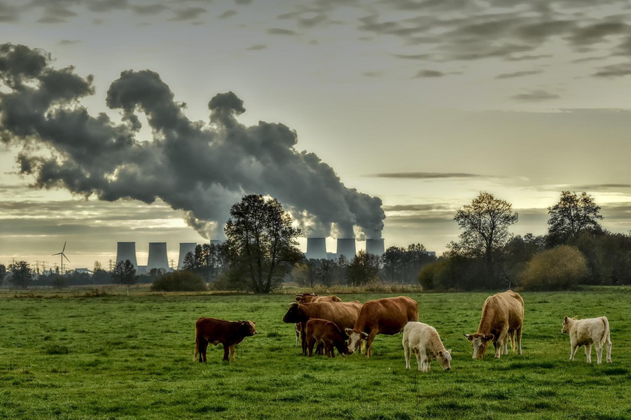
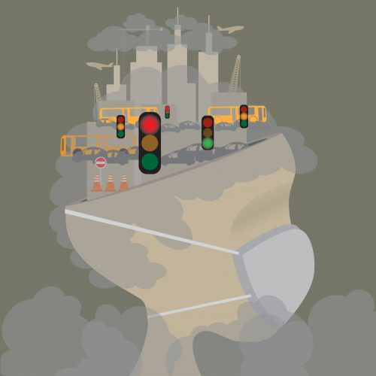

Geospatial and Temporal Patterns of Air Pollution and Their Influence on Population Health in Germany
Geospatial
Presented by
kiruthika subramaniam
Rachana Patel
Data Source: European Environmental Agency
Notes:
Hello everyone! Good morning.
Travel through time with us to uncover Germany's air quality story.
As Germany advanced, its air went through changes, affecting not just nature but also the well-being of its people.
From the past to the present, this journey reveals how air pollution has shaped the nation and impacted lives, sometimes tragically with premature deaths.

Slide 2

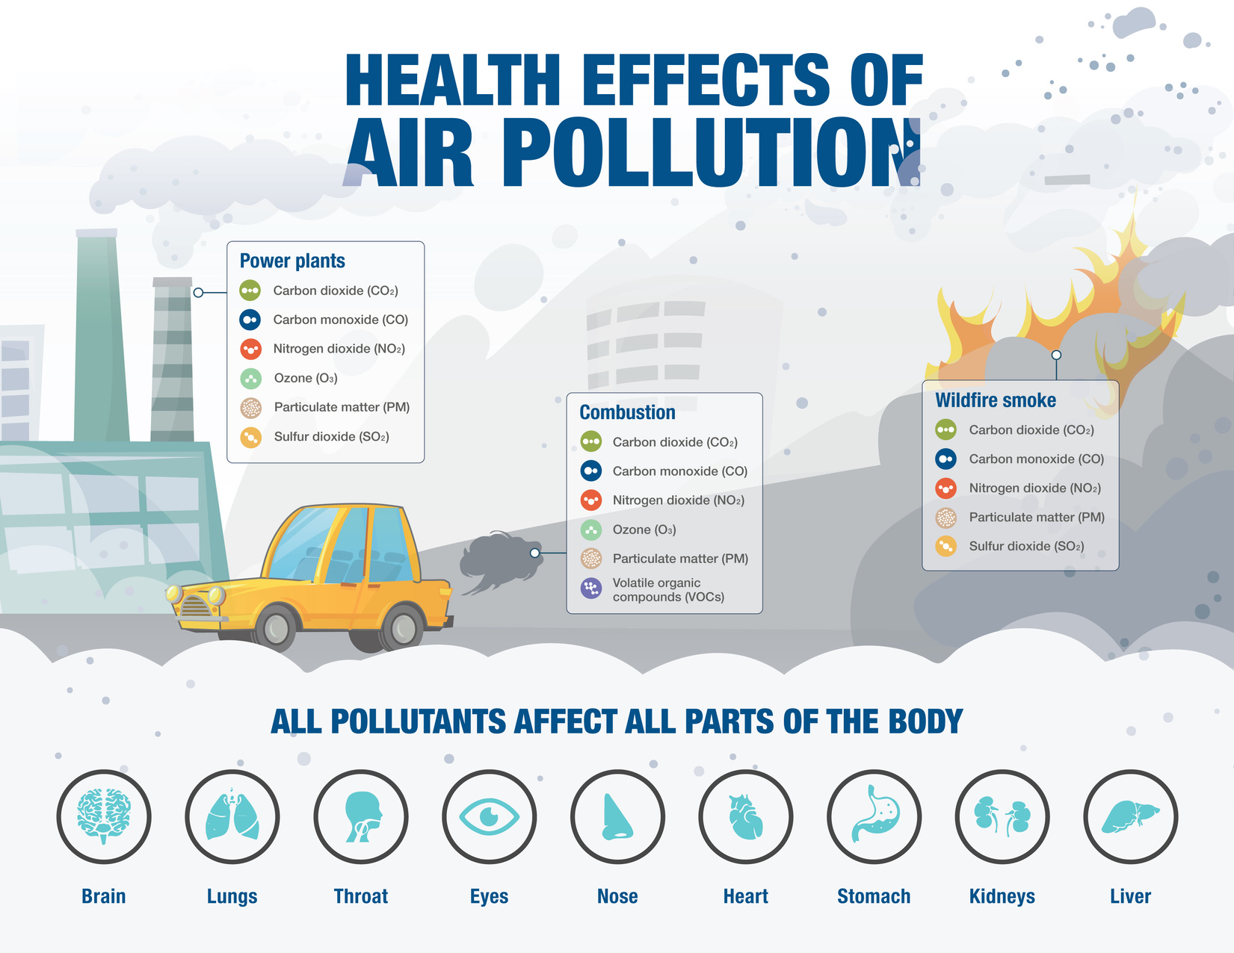

Air pollution
Air pollution is the presence of harmful substances in the air.
Common Air pollutants
NO2 (nitrogen dioxide)
O3 (ozone),
PM2.5 (fine particulate matter).
Notes:
Air pollution is the presence of harmful substances in the air. NO2 (nitrogen dioxide), O3 (ozone), and PM2.5 (fine particulate matter) are common pollutants. NO2 is a gas released from combustion processes, O3 is a secondary pollutant formed by chemical reactions, and PM2.5 consists of tiny particles suspended in the air, often originating from combustion and industrial activities. These pollutants can have adverse health and environmental effects as shown in the image.

Slide 3
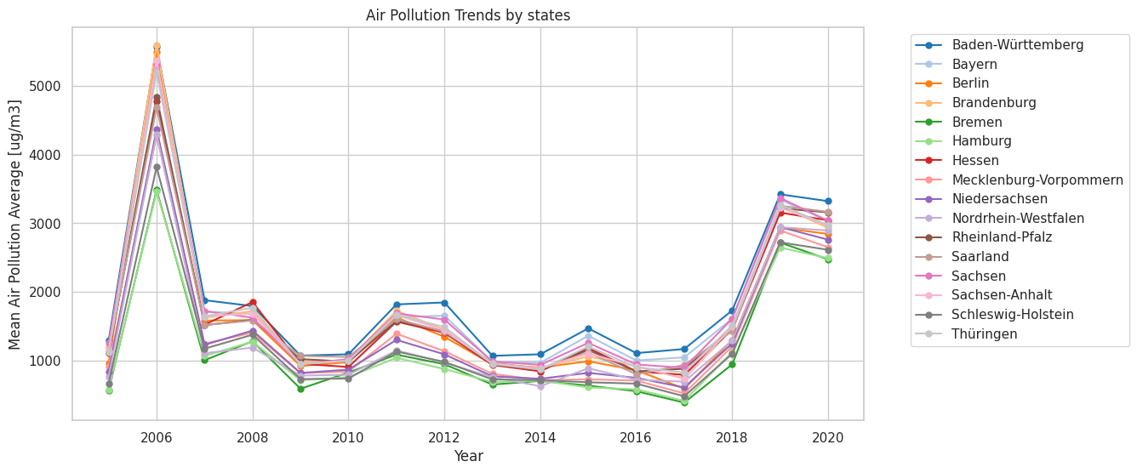
State-by-State Air Pollution Trends in Germany Over Year:
The pollution peak in 2019, but the subsequent decline in 2020 suggests progress in air quality control efforts.
Notes:
In our analysis covering 2006 to 2020, we tracked air pollution levels (measured in µg/m³) across different regions.
Each line represents a region. You might notice a spike in 2006, especially for O3 (ozone).
But don't worry, that's because we didn't have data for NO2 and PM2.5 that year. What's important is that in 2019, pollution rose again.
However, by 2020, there's a promising decline, showing that efforts to improve air quality are making a difference.

Slide 4
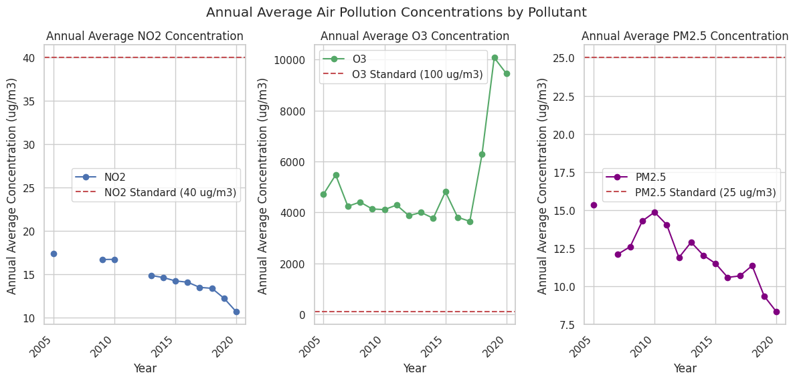
Annual Average Air Pollution Levels in Germany: NO2, O3, and PM2.5
The red line represents the air quality standards established by the World Health Organization (WHO)
Nitrogen dioxide (NO2) and fine particulate matter (PM2.5) consistently maintain levels
O3 levels exhibit a noticeable upward trend, particularly in recent years.
Notes:
This graph is a window into our air's quality.
The red line represents the WHO's air quality standards. While NO2 and PM2.5 remain steady within these limits, O3 levels show a concerning upward trend, especially in recent years.
This increase could be attributed to factors like weather patterns, increased vehicular traffic, industrial activities, and pollutants from distant sources, posing risks to our health and the environment.

Slide 5
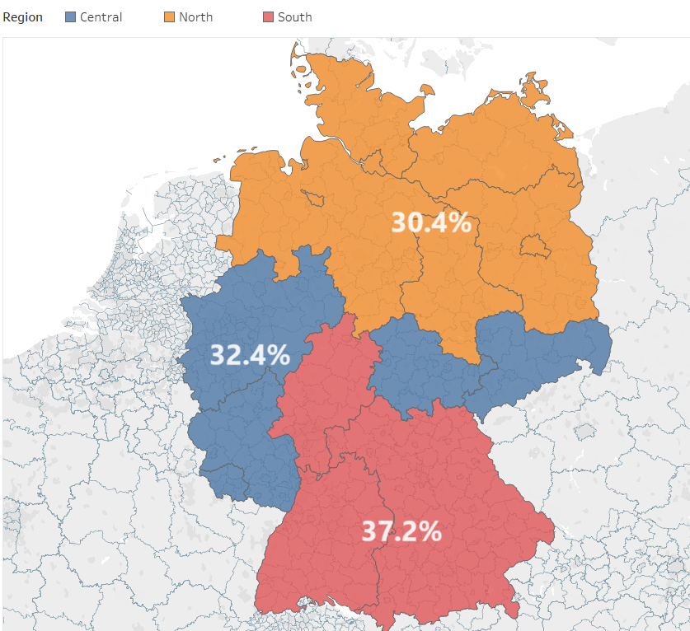
Geographical Analysis of Air Pollution in Germany by Region:
south region with 37.2%
central region at 32.4%,
north region at30.4%
Southern region's pollution is high due to industries, urbanization, traffic, and trapping pollutants by climate.
Notes:
This map offers a comprehensive view of the overall air pollution levels, presenting a clear distribution across three distinct regions: Central, North, and South. Notably, we observe that the Southern region experiences the highest pollution levels, followed by the Northern region, with the lowest pollution levels found in the Central region."
The Southern region experiences higher pollution due to a combination of industrial emissions, dense urbanization, vehicular traffic, and climatic conditions that can trap pollutants, resulting in elevated air pollution levels.

Slide 6
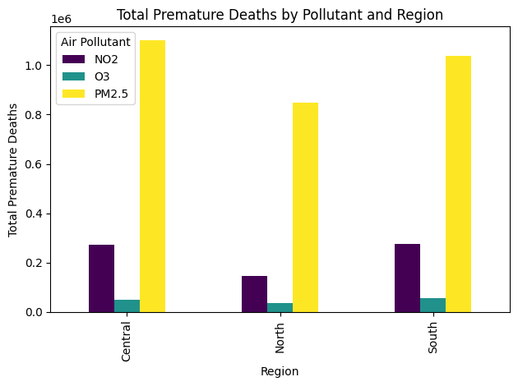
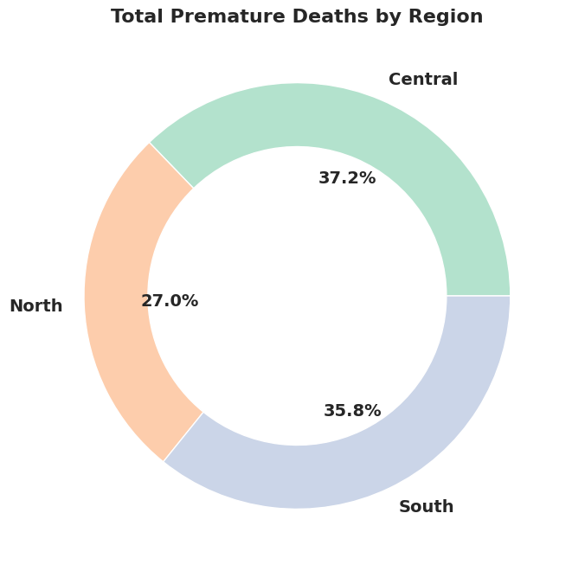
Regional Analysis of Premature Deaths Caused by Pollutants:NO2,O3,PM2.5
PM2.5 causes the most premature deaths in all regions.
Central has the highest premature deaths.
Notes:
This chart in the right showcases a higher prevalence of premature deaths in the central region, followed by the north and then the south.cause of higher death could be inadequate healthcare facilities or higher population density of central region , leading to increased exposure and vulnerability to the adverse effects of air pollutants.Meanwhile, the left graph showcases premature deaths attributed to different air pollutants in 3 distinct regions. Taller bars indicate more early deaths because of pm2.5 in every region . PM2.5 is tiny airborne particles, pose a greater risk as they can deeply penetrate the lungs and enter the bloodstream, causing various health issues and increasing the risk of early death.

Slide 7
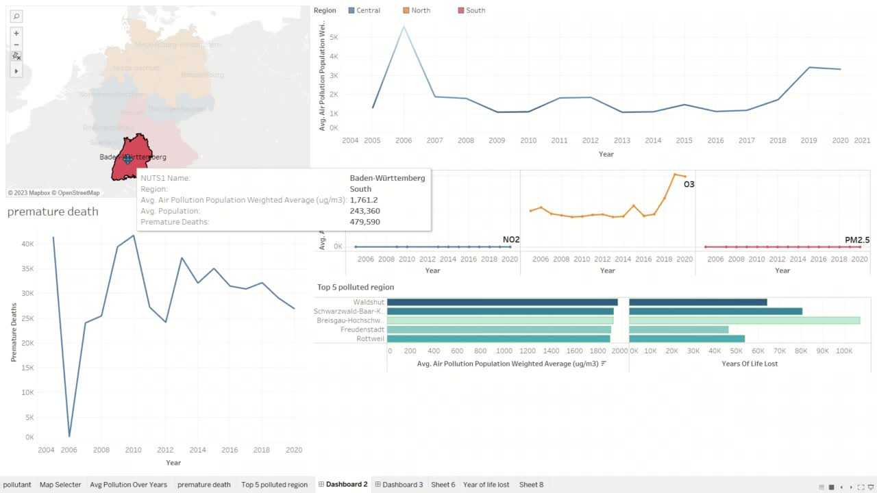
Notes:
This dashboard offers a clear view of air pollution trends in Germany. It lets you select a state and see how pollution levels have changed over the years. You can also check individual pollutants variations, discover the most polluted cities, and understand the health impact through premature deaths data. It's a valuable tool for addressing Germany's air pollution challenges.

Slide 8
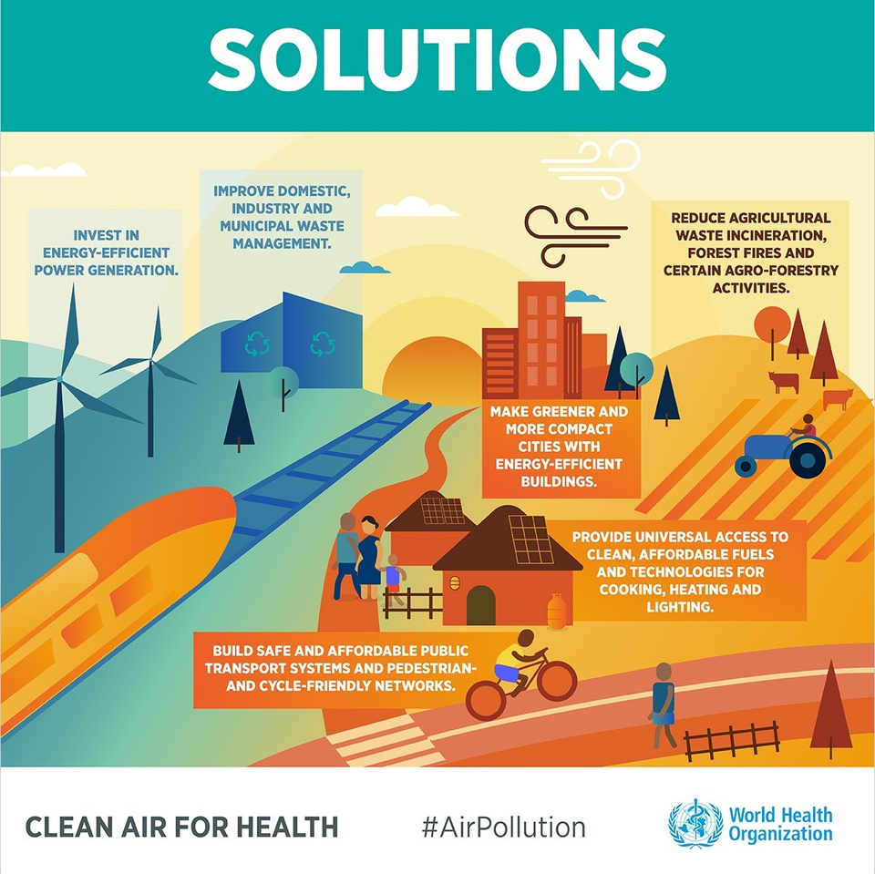
Conclusion:
Progress and Challenges: Germany's efforts to combat air pollution have shown progress with a decline in 2020 compared to a peak in 2019. However, this journey is marked by ongoing challenges.
Pollutant Focus: The primary pollutants of concern are NO2, PM2.5, and O3 which cause serious health impacts sometimes like premature deaths. These pollutants have varying trends and require continued attention.
Control Measures:
Act now for cleaner air
Advocate for stronger policies
Choose eco-friendly transportation
Embrace green technologies
Share knowledge to raise awareness
Notes:
Germany's fight against air pollution has shown progress, with a dip in 2020 after a peak in 2019. However, challenges remain, especially with NO2, PM2.5, and rising ozone levels (O3). The pollution in the southern region underlines the impact of industry and cities.
Supporting policies and eco-friendly transport is key to cleaner air. Embracing green tech and sharing its benefits will drive a sustainable future

Slide 9


